Slide 1
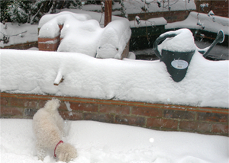

Winter weather forces schools to close
By <Your Name>

